Slide 1
Academic Application Package
Cover Letter + CV (due Sept. 17 for in-class peer review)
Research Statement (due Sept. 23 for in-class peer review)
Teaching Statement (due Sept. 30 for in-class peer review)
Diversity Statement (due Oct 7 for in-class peer review)
First 5-min of Job Talk (due Oct. 15)
Entire package revised (due Nov. 12)
Webpage (due Dec. 3)

Slide 2
Cover Letters and CVs In-Class Peer Review
EXERCISE:
When you get to the breakout room you will go to Files/CoverLettersCVs and find the pdf belonging to your breakout room partner
For ~10 minutes read the materials then use ~10 min for feedback
PROMPTS FOR FEEDBACK (also on Canvas):
does the applicant fit the job ad?
is the writing clear and compelling?
is the significance of the work explained?
do you get a sense of personality in the cover letter?
is it easy to understand what the candidate has accomplished?
is there anything missing or time unaccounted for in the CV?
can you easily contact the candidate?
is the material personalized towards the institution (as much as possible)?
Notes:
Tell them to go to the Canvas In-class exercise page:
https://utexas.instructure.com/courses/1284211/assignments/5202945?module_item_id=10385180
Pull students back in 20 minutes

Slide 3
Research Statements – why?
PURPOSE:
presents your work in non-specialist terms and in broader context of your discipline
shows your capacity for original ideas that contribute wisely to what has been done already
allows you to display the enthusiasm and creativity you have as a scientist
lays out a career roadmap for the candidate
gives you an identity as a scientist
shows committee that you are prepared to start a research program at the scale appropriate for that institution (i.e. realistic)
ensures that the committee won’t hire someone who is going to fail
allows the committee to get a sense of the anticipated startup needs, where overlap exists with existing faculty, and the suitability of the research program for what the institute can provide

Slide 4
Research Statements – how to?
Tell a COMPELLING story:
why is your research important? Why do you do what you do?
from AAAS

Slide 5
Research Statements – how to?
Tell a COMPELLING story:
why is your research important? Why do you do what you do?
how does your work fit into the big questions being asked in your broader scientific field right now? - even if you’re not working on those questions – can you? would you?
from AAAS

Slide 6
Research Statements – how to?
Tell a COMPELLING story:
why is your research important? Why do you do what you do?
how does your work fit into the big questions being asked in your broader scientific field right now? - even if you’re not working on those questions – can you? would you?
what is the overarching theme that connects your research projects?
from AAAS

Slide 7
Research Statements – how to?
Tell a COMPELLING story:
why is your research important? Why do you do what you do?
how does your work fit into the big questions being asked in your broader scientific field right now? - even if you’re not working on those questions – can you? would you?
what is the overarching theme that connects your research projects?
if you are not passionate about your current research, how are you taking what you know and applying it to new ideas?
from AAAS

Slide 8
Research Statements – how to?
Tell a COMPELLING story:
why is your research important? Why do you do what you do?
how does your work fit into the big questions being asked in your broader scientific field right now? - even if you’re not working on those questions – can you? would you?
what is the overarching theme that connects your research projects?
if you are not passionate about your current research, how are you taking what you know and applying it to new ideas?
R1/R2/Research Scientist:
how are your ideas shaping the future of the field?
if you have proposals submitted be specific with funding agencies/solicitations and collaborators
at R1s having submitted and/or awarded proposals will give you a bump – this takes the job of evaluating your work out of the hands of the committee since a panel/program manager has already said it’s a good idea
consider: will you be the person at the school who is an expert in X or among a group of experts in X? If the latter, how will you stand out and contribute?
from AAAS

Slide 9
Research Statements – how to?
Tell a COMPELLING story:
why is your research important? Why do you do what you do?
how does your work fit into the big questions being asked in your broader scientific field right now? - even if you’re not working on those questions – can you? would you?
what is the overarching theme that connects your research projects?
if you are not passionate about your current research, how are you taking what you know and applying it to new ideas?
SLAC:
how will your research involve students?
how will your research be integrated into your curriculum?
how does your research compliment (and not overlap with) others in the (often) small department/school
from AAAS

Slide 10
Research Statements
IN-CLASS EXERCISE: Brainstorming your research motivation
why is your work important?
why are you interested in your research?
what is one important thing your future research will answer?
what makes a good scientist?
Spend ~5 minutes thinking about the answers to these questions. Then, I want some of you to volunteer your answer to this question: Who are you as a scientist? by writing it into the chat in less than 2 sentences.
from AAAS
Notes:
Spend just 5 minutes thinking about the answers to these questions for you and when we come back I want some of you to volunteer the answer to this question: Who are you as a scientist?
Did the CV lecture and with questions I got to this point in this lecture. Continue from this point onwards.

Slide 11
Research Statements – how to?
Tell a REALISTIC story:
show the committee that your years of graduate and postdoctoral study have helped you to know the difference between good ideas and good intentions
build ideas on solid data (your PhD work or the work of others)

Slide 12
Research Statements – how to?
Tell a REALISTIC story:
show the committee that your years of graduate and postdoctoral study have helped you to know the difference between good ideas and good intentions
build ideas on solid data (your PhD work or the work of others)
consider: what happens if funding in your field dries up? what will you work on?

Slide 13
Research Statements – how to?
Tell a REALISTIC story:
show the committee that your years of graduate and postdoctoral study have helped you to know the difference between good ideas and good intentions
build ideas on solid data (your PhD work or the work of others)
consider: what happens if funding in your field dries up? what will you work on?
demonstrate independence from your adviser
the best plans usually build on the prior experience of the applicant but are not direct extensions of their graduate/postdoctoral work

Slide 14
Research Statements – how to?
Tell a REALISTIC story:
show the committee that your years of graduate and postdoctoral study have helped you to know the difference between good ideas and good intentions
build ideas on solid data (your PhD work or the work of others)
consider: what happens if funding in your field dries up? what will you work on?
demonstrate independence from your adviser
the best plans usually build on your prior experience but are not direct extensions of your graduate/postdoctoral work
tailor your statement to the type of institution you are applying
If SLAC:
keep your expectations in check considering a higher teaching load
be sure to indicate how you would involve undergraduates in research
committee more likely to be non-specialists
Notes:
I suspect that it is more likely that smaller schools will scrutinize the research needs more closely than bigger schools with bigger budgets.

Slide 15
Research Statements – how to?
Tell a REALISTIC story:
show the committee that your years of graduate and postdoctoral study have helped you to know the difference between good ideas and good intentions
build ideas on solid data (your PhD work or the work of others)
consider: what happens if funding in your field dries up? what will you work on?
demonstrate independence from your adviser
the best plans usually build on your prior experience but are not direct extensions of your graduate/postdoctoral work
tailor your statement to the type of institution you are applying
If SLAC:
keep your expectations in check considering a higher teaching load
be sure to indicate how you would involve undergraduates in research
committee more likely to be non-specialists
If R1:
do they have people there working with similar instruments?
do they have people there working on similar ideas?
can the school afford the kinds of things you want to do? (small schools?)
Notes:
I suspect that it is more likely that smaller schools will scrutinize the research needs more closely than bigger schools with bigger budgets.

Slide 16

Research Statements (golden rule)
Tune your statement to the department you are applying to

Slide 17

OMG, this is going to be so much work!
Notes:
Imagine you are on a search committee. You have all of your normal job duties and family responsibilities to deal with, but now you also have to review people for a new position. Ugh! So. Much. Work.

Slide 18

Yay! A new colleague who seems like a nice person!
He’s too good for us, I hope he doesn’t leave!
Yay! I’m excited to have someone interesting to work with!
Notes:
The best part of being on a search committee is meeting cool people with neat ideas who can eventually be colleagues – THIS IS THE PURPOSE THAT THE RESEARCH STATEMENT SERVES!
“Which people are conducting the most exciting work?” and “Who can I see myself working with?” are at the top of their minds

Slide 19
Research Statements
ORGANIZATION:
Summary
your overall research goals, themes, motivation and approach [brainstorm in chat]
can be hypothesis or question based
Past and current research
can be two separate sections if needed
what is the motivation for this work and how did you contribute to this?
how are your results significant?
Future research
this should build on previous sections
perhaps short- and long-term goals in two sections
be realistic in terms of time and startup that the institution can provide
think about how students will be involved in your research
Notes:
personally, I have done this with subheadings of Current and Planned Research, but I have also created subheadings that group specific research topics I am interested in with current and future discussions within each

Slide 20
motivation
knowledge gaps I want to address
Statement when I applied to UTIG
Notes:
OK, I’m sharing my own research statement because I feel uncomfortable dissecting anyone else’s not because I think it’s the best thing ever written.
Also, this version is what I had when I was just one year out from my PhD. I’ve added some other versions of my CV for different jobs on Canvas.
personally, I have done this with subheadings of Current and Planned Research, but I have also created subheadings that group specific research topics I am interested in with current and future discussions within each

Slide 21
PhD research
postdoc research
Notes:
personally, I have done this with subheadings of Current and Planned Research, but I have also created subheadings that group specific research topics I am interested in with current and future discussions within each

Slide 22
new funded research and/or planned proposal submissions
Notes:
proposals demonstrate that I’m already acting the part of a research scientist

Slide 23
Description of potential collaborations (could have been more detailed but I was keeping to 2 pages)
Notes:
proposals demonstrate that I’m already acting the part of a research scientist

Slide 24
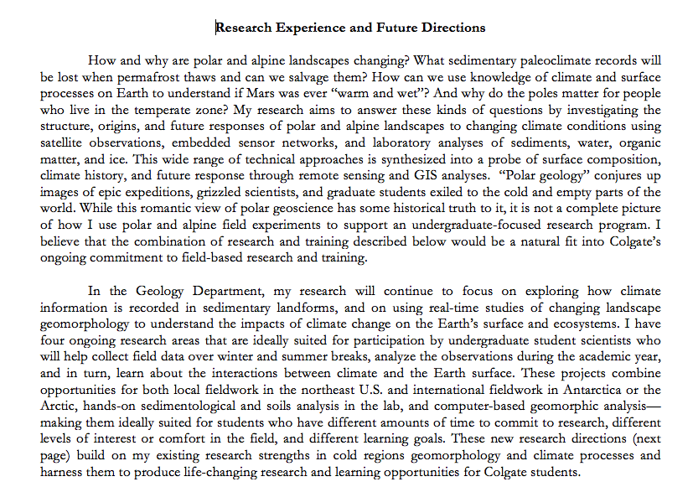
motivation
general topics of interest for ugrad involvement
Joe Levy, SLAC Statement

Slide 25
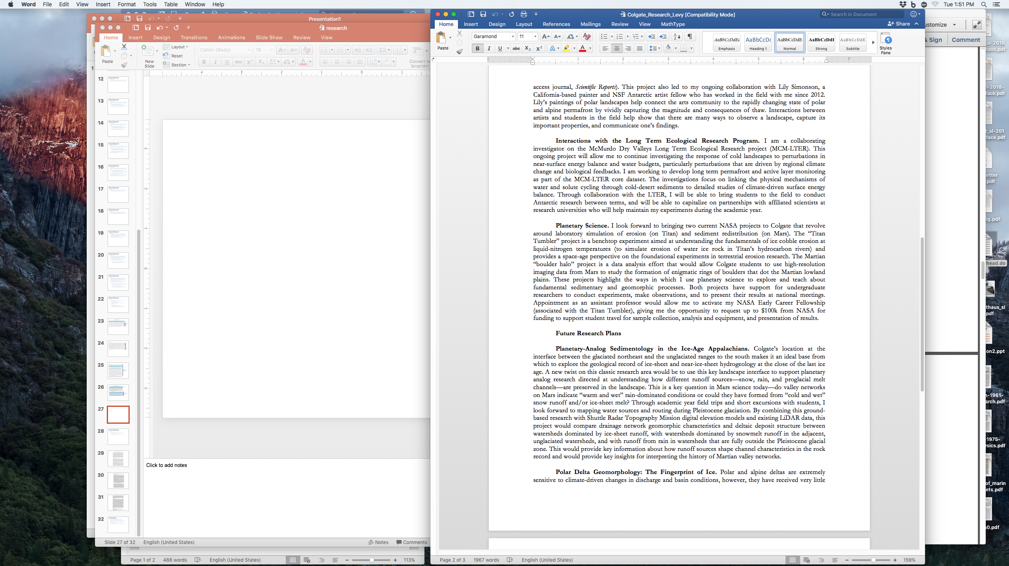
use of local resources
Joe Levy, SLAC Statement

Slide 26
Research Statements
ORGANIZATION:
Summary
your overall research goals, themes, motivation and approach.
can be hypothesis or question based.
Theme 1…Theme 2…
can be two separate sections past/present and future contributions
Notes:
personally, I have done this with subheadings of Current and Planned Research, but I have also created subheadings that group specific research topics I am interested in with current and future discussions within each

Slide 27
motivation
theme 1 (what I’ve done already)
Notes:
personally, I have done this with subheadings of Current and Planned Research, but I have also created subheadings that group specific research topics I am interested in with current and future discussions within each

Slide 28
theme 1 (what I’m planning next)
theme 2 (what I’ve already done)
Notes:
personally, I have done this with subheadings of Current and Planned Research, but I have also created subheadings that group specific research topics I am interested in with current and future discussions within each

Slide 29
theme 2 (what I plan to do next)

Slide 30
For Next Week…
Exercise: Create a ~2pg Research Statement for next Wednesday
Think about how and why you got started with your research
What motivated you to spend so much time on answering the questions you developed?
How does your past/current research connect to where you want it to go?
Focus on the scientific results, not your experience or expertise
Do not overhype your work
Cite the existing literature well and accurately* – nobody works in a vacuum

